Slide 1
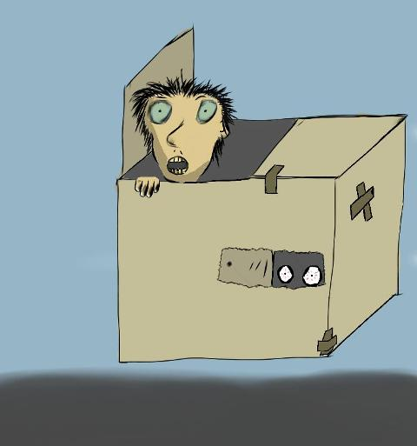
LibGuides Working Inside the Box
COMO XXIII
Athens GA
October 7, 2011
Casey Long, Agnes Scott College
Jason Puckett, Georgia State University
Notes:
Casey: In this presentation we plan to walk you through some of the best practices for basic libguide design. This includes: planning your approach, writing for the web, choosing boxes that help you manage and assess content, and incorporating the right amount of images into the guide to make it visually appealing. Then we will talk with you about options for more dynamic content to enhance your guides and finally we will discuss some uses and marketing tips you may not have considered.

Slide 2
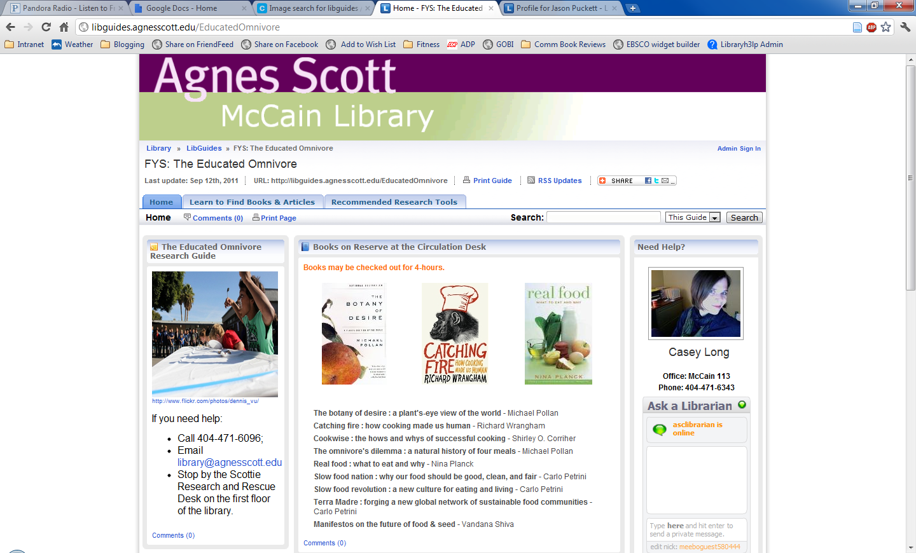
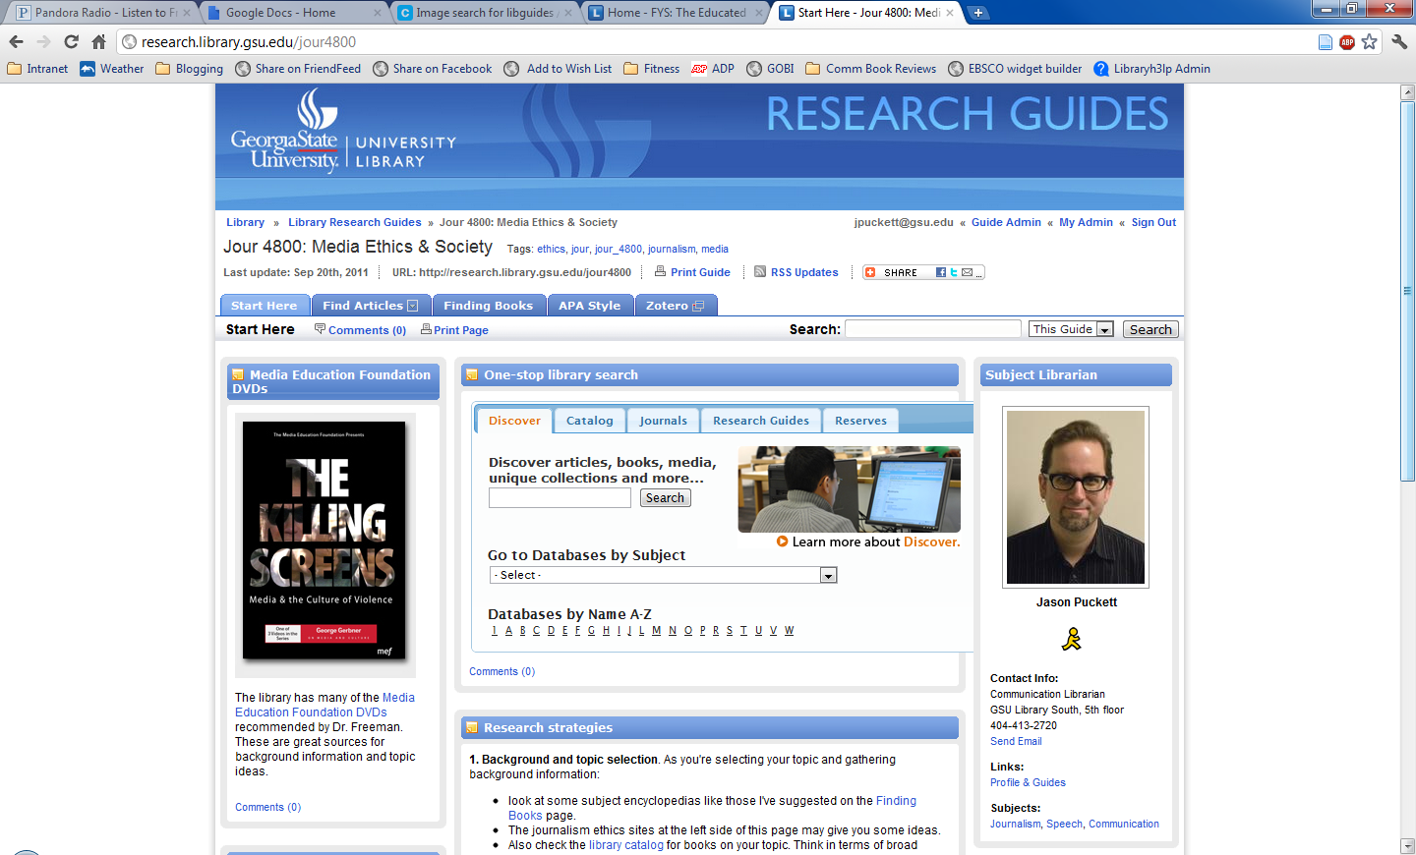
___ _ _ __ ____
What’s a LibGuide?
springshare.com/libguides
libguides.agnesscott.edu
research.library.gsu.edu
Notes:
Libguides is an inexpensive content management system for creating pathfinders or research guides. A basic guide requires no technical expertise on the part of guide authors, but there is freedom for more advanced content creators to make the guides more dynamic. We’re going to talk about Libguides specifically, but this is just one example of many similar products. much of what we are covering can be applied to whatever product you’re using for your research guides
Researching this topic in the LIS databases is surprisingly tricky -- LISTA thesaurus suggests “finding aids” as a subject term, but there’s lots of inconsistency due to terminology. Most articles about Libguides do not include this SH: pathfinders, research guides, or other terms are common. some articles are tagged with simply “software” as the most specific subject term

Slide 3

______ ___ ___ ___
Writing for the web
“The format is very clear and neat. The first two [guides] just make me feel dizzy. Too many words on it – very messy.”
– student response to LibGuides
(Hintz et al)
Minimal text
Lists, not text blocks
Web readers skim
Critical content above the fold
Avoid “click here.” Users know links when they see them
Use emphasis sparingly
Good style guides from Yahoo:
styleguide.yahoo.com/writing/write-web/get-point
styleguide.yahoo.com/writing/write-web/shape-your-text-online-reading
Notes:
Best practices guidelines for web content apply to us -- most librarians aren’t aware of these good quick tips: http://styleguide.yahoo.com/writing/write-web/get-point
Use minimal text. List are preferable to blocks of text. This is something I’m struggling with on my own guides
Avoid “click here” -- just make your links visible.
Use emphasis sparingly: http://styleguide.yahoo.com/writing/write-web/shape-your-text-online-reading

Slide 4
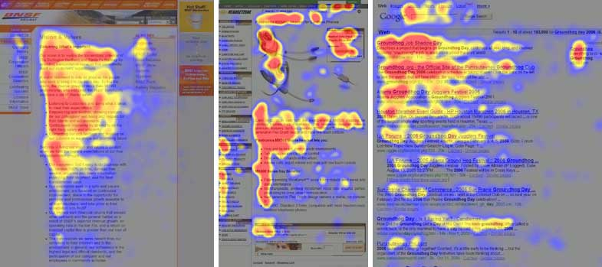
Writing for the web
Web readers skim: the F shape
Above the fold
useit.com/alertbox/reading_pattern.html
Notes:
Web readers skim, not read start to finish: the “F-shaped” reading pattern emerges from eye-tracking studies http://www.useit.com/alertbox/reading_pattern.html
Place critical content “above the fold” – on the first screen

Slide 5
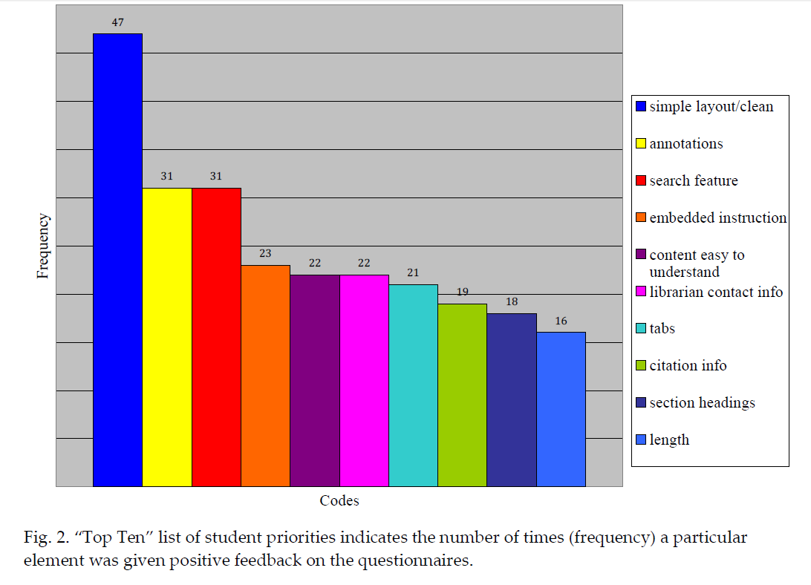
Design and why it matters
Hintz, K., Farrar, P., Eshghi, S., Sobol, B., Naslund, J.-A., Lee, T., Stephens, T., et al. (2010). Letting students take the lead: A user-centred approach to evaluating subject guides. Evidence based library and information practice, 5(4), 39-52.
Notes:
Image: top ten chart from p. 45 of Hintz et al shows “simple/clean layout” as #1 factor by students for why they would use one guide over another
Other crucial features: Concise/clear annotations and search features keep students coming back and using your guides

Slide 6
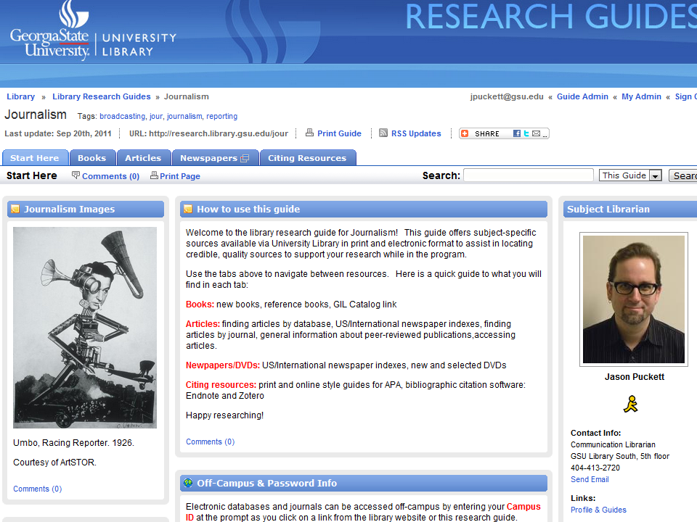
Design and why it matters
Colors: simple and consistent
Images can direct attention
Notes:
Using images
images draw the eye e.g. http://research.library.gsu.edu/jour
The image is the first thing you notice on the page, and the gaze of the face directs your eye to the content box
Colors: keep it simple. consistent look & feel helps users and avoids distracting from content

Slide 7
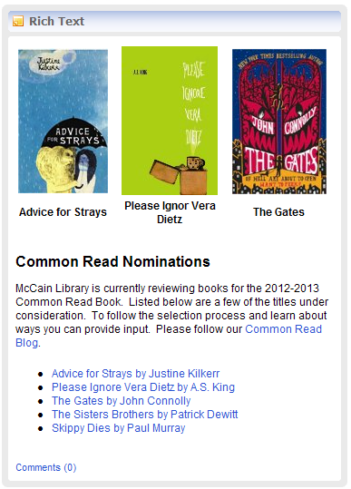
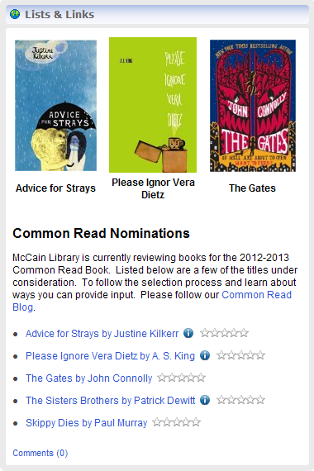
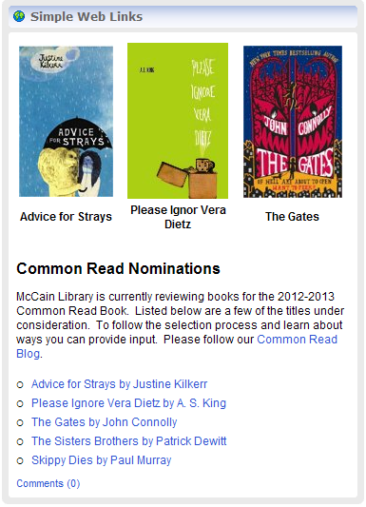
Boxes: The Basics
Box A
Box C
Box B
Notes:
The final aspect of design we’d like to talk about is choosing boxes that provide a firm foundation for your guide. Take a look at the boxes on this slide. Do you have strong feelings about one box over another? What if we told you that boxes B and C would let you track how frequently those links were used?
Obviously, choosing the box that will provide you with the most information on how your guide is being used is the best option. Box B is the Simple Web Links bok and Box A is the List and Links box. Both of these boxes allow you to use the Rich Text portion of the box to provide introductory text and images. The links, however, are able to track usage of those resources and are able to be reused. In addition, Simple Web Links and Lists and Links provides options for displaying a description of the hyperlinked resources. In Simple Web Links the descriptions when you mouse over the link. In Lists and Links you are able to provide a description underneath the link and provide additional information accessible from an icon next to the link. One final thing to note about the differences between these boxes is that the Lists & Links box will let you create a bulleted list that includes trackable links and non-linked bulleted items.
In the presentation we gave at COMO a graphic designer in the audience indicated that he preferred the first box because it was less busy and the bullets were more nicely laid out than the other two boxes. We really appreciated this input because it helped us understand why designing Libguides can be so frustrating. Many librarians probably use the Rich Text box because it enables them to create a more appealing bulleted list, but for assessment reasons it is not the best choice.
Libguides does make it difficult to switch boxes once you start adding content. Fortunately, they have made changes recently that do allow you to change a Rich Text box to another box type. Also, depending on how far you go in creating a Simple Web Link Box or a List and Links box you can change the box type to one of these two options.
7

Slide 8
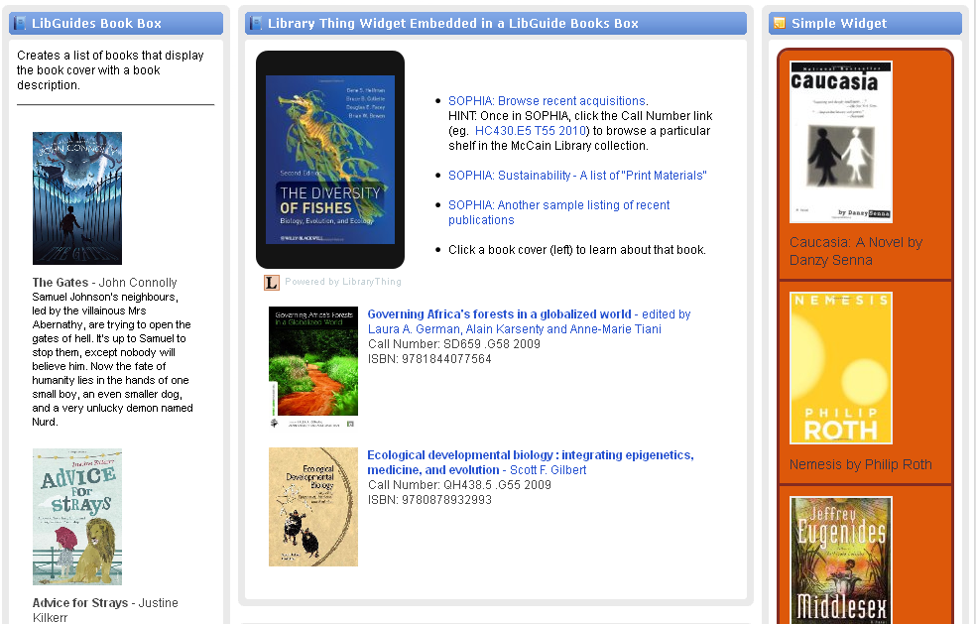
Creative Options for Displaying Books
Notes:
So far we have covered some basic design tips that will help you build a firm foundation for your guides. Once you are ready to move on to the next level with your guides, here are some boxes and tools that can make them more dynamic. The first and most frequently used option is using the Libguides Book Box.
On the left you can see what the basic Libguides Book Box looks like in it’s finished form. It allows you to put the title, author, call number, date of publication, and a description of the book. If you have the ISBN number it also has a feature that will retrieve the book cover from Amazon or Syndectic. Sometimes these two sources do not have a book cover and in those instances you can either leave out the book cover or there is an option to insert a blank book cover. On some guides designers choose to provide a book cover for each book on others they may use one book cover for the first book and then just let the rest of the books be listed without a book cover.
Many libraries are also option to use a social networking book tool like Goodreads, LibraryThing, and Shelfari to highlight books. On this screen you can see two widgets from Library Thing. The first is a flash widget at the top of the middle box. Every 15 seconds it displays a different book cover. Nelson Fredsell, an MLIS student at Valdosta State and a volunteer with McCain Library at Agnes Scott embedded this Library Thing flash widget into to a basic LibGuides book box. Notice that next to the widget there are bulleted hyperlinks to a list of recent books and some canned catalog searches. In addition underneath the widget are two additional books that he has highlighted. The widget and the bulleted list are in the rich text portion of the box and the additional box are displayed using the add a book feature of the box.
All three of these services have multiple widgets you can use. These can be customized to fit your design needs. To get started with these tools you do need to create an account and then add your books to the account. Each of these allow you to add books in bulk from a list of resources that include the ISBN numbers. What we have done at Agnes Scott is create a list of box using RefWorks and exporting those to a spreadsheet. Then we upload that spreadsheet to the social networking book tool. If we are using these books for a subject specific guide we can tag the books with a subject heading. Then when we create the widget we just need to limit the widget to books that have that subject heading.
Keep in mind that on the previous slide the boxes we displayed highlighted three book covers. You are not limited to using the LibGuides book box to display book covers.
8

Slide 9
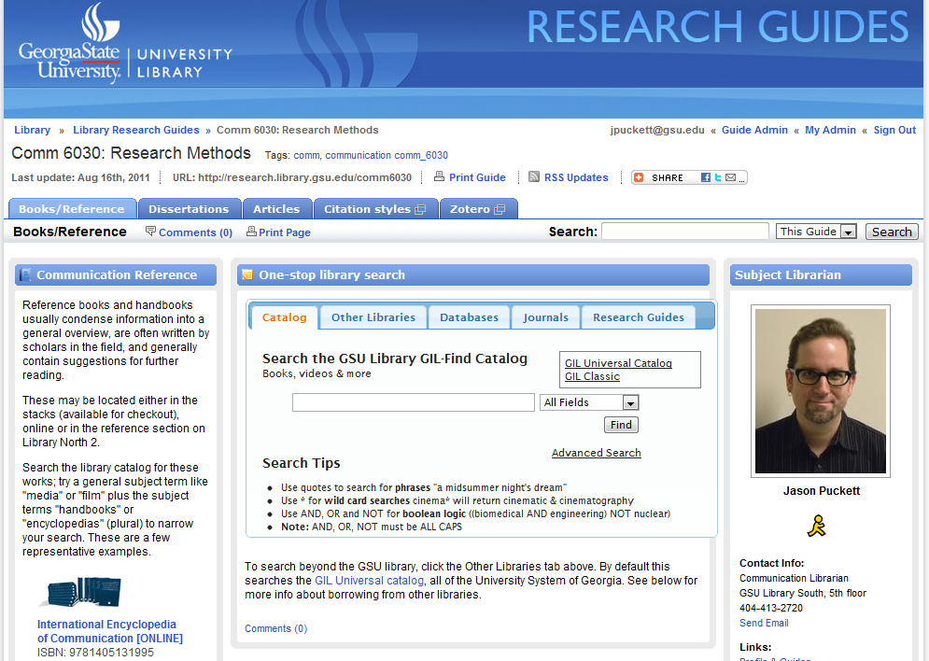
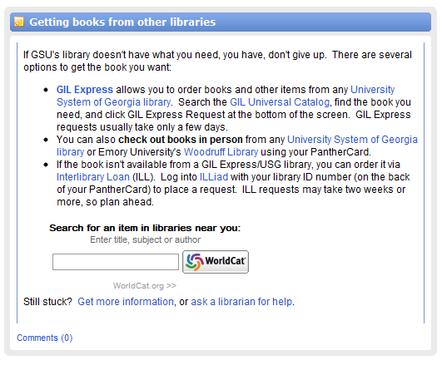
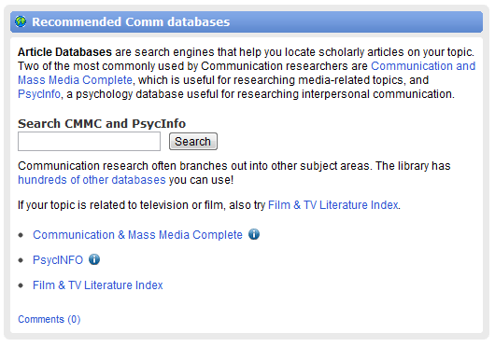
_____ _______
Search widgets
Notes:
Search widgets: make guides functional pages rather than just lists of links. The student study I showed earlier mentioned this as a feature that students value highly in a guide. This can help keep students coming back to use it – if they think of it as a useful search page rather than just a page of text.

Slide 10
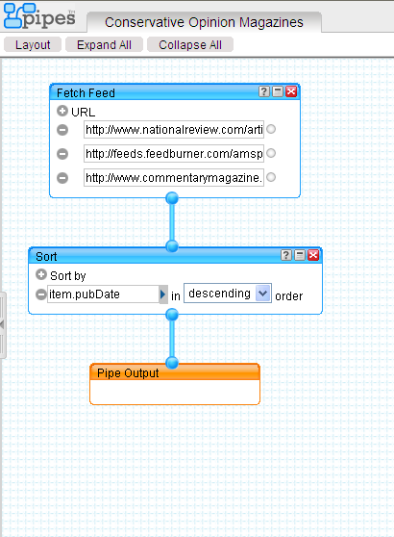
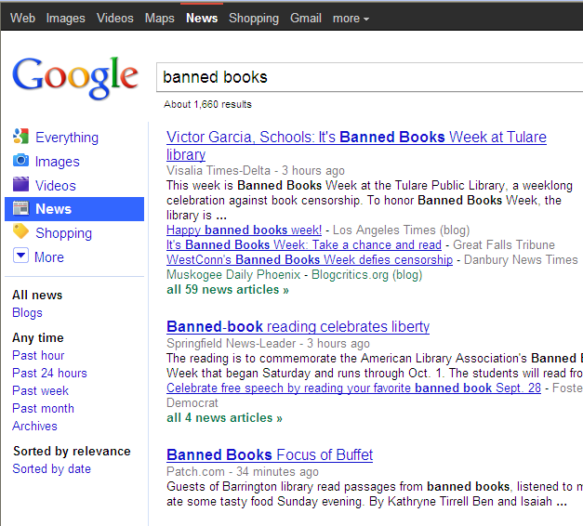
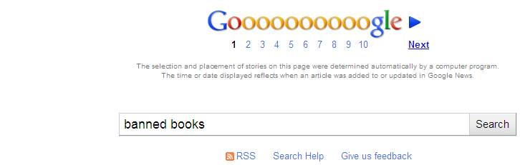
Build More Powerful RSS Feeds
Notes:
Another fun tool to add to your guide is an RSS feed. LibGuides provides an RSS feed box. In the RSS feed box you will be prompted to add an RSS url and identify how many articles should be displayed. In addition you can designate whether the articles should have a description appear below the link to the article or appear when the individual mouses over the article title.
The main draw back to this feature is that it only allows you to display one RSS feed in a box. There are a couple ways you can get around this. First you could create a RSS feed that combines several feeds into one using Yahoo Pipes. There is a slight learning curve with this, but as we’ve provided a short video that will explain this process on the libguide for this presentation. The screen shot above on the left shows the construction of a yahoo pipe that pulls from three rss feeds and is sorting those feeds by date. This produces an RSS url that I can insert into the Libguides RSS box.
One way we have used this at Agnes Scott is to create three RSS feed boxes that display content from different types of political opinion magazines: Conservative, Liberal, and Centrist. Another option we are thinking about is to create a pipe for classes that require students blog about their research process. The pipe could be created to merge all the student blogs into one feed that is accessible from the LibGuide.
Another option for creating a rss feed from multiple sources is to use the RSS feature provided by Google, Bing and Yahoo for their news sites. In the second screen shot you can see a search conducted in Google News. At the bottom of the page is an rss feed creator I can use to get a URL for this search and add it to my guide.

Slide 11
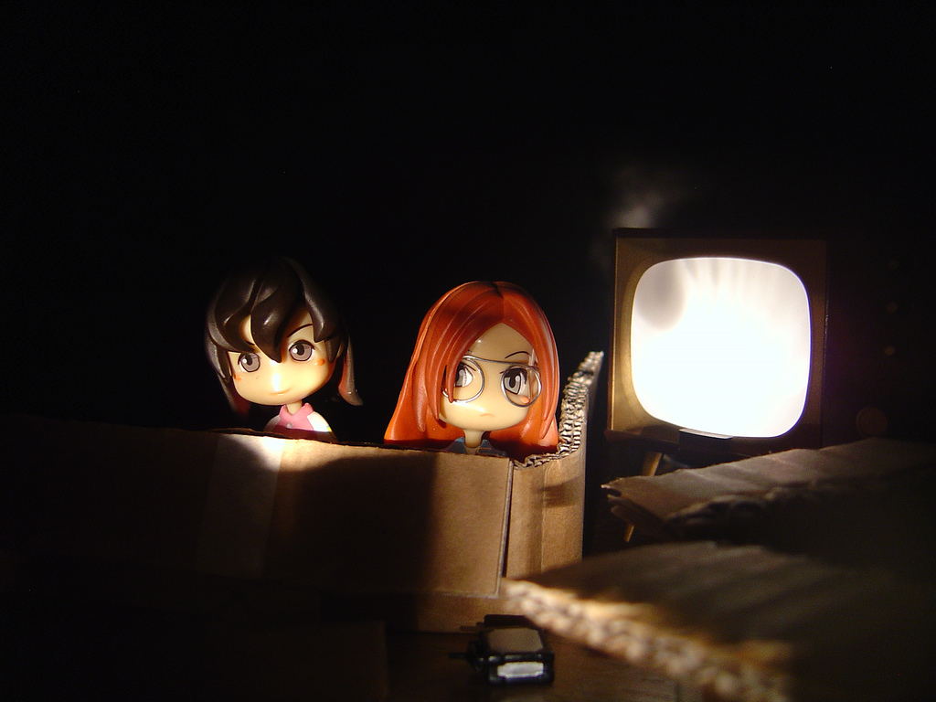
Embedding Video
From Flickr User puuikibeach
Notes:
LibGuides allows you to embed videos into your guides. The key thing to know about this, however, is that it will not host the videos for you. Unless you have a streaming media server at your institution you will need to upload your videos to a service, such as YouTube, Picasa, Slideshare, etc that will host your videos and provide an embeddable script for that video. At Agnes Scott College, we are working on developing our own YouTube Channel that will host all of our videos.
To create videos you have a lot of free options. First it is possible to create a presentation using powerpoint. You can add voice overs to your slides and upload the presentation to Slideshare. Also, on your computer you may have Windows Movie Maker or Microsoft Photo Story (if you are a Mac user it would be iMovie) that will let you upload pictures and (depending on the tool live action video) and provide voice over instructions.
The most popular option, however, is to use a screen capture software. Screen capture software follows your movements on the screen and allows you to provide a voice over. Jing is the most highly recommended tool for this. Plus, Jinghosts your videos for you so you do not need to worry about uploading your videos to a secondary source.
11

Slide 12
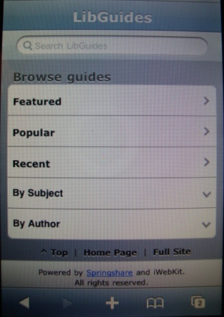
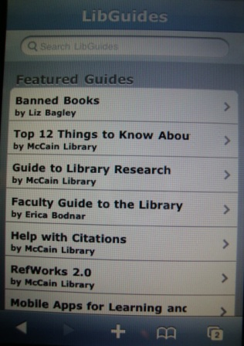
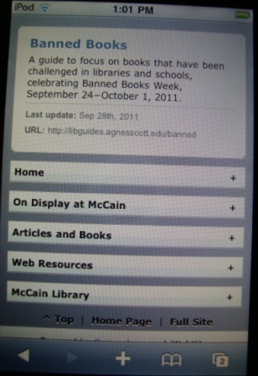
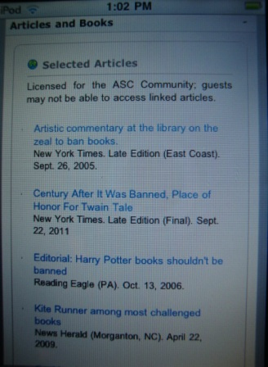
Oh the Mobile Possibilities!
Notes:
One of the greatest features of LibGuides that you may not be aware of is that it has a fabulous mobile interface. As you can see on these screen shots, the design is simple and clean. The launch page provides users with the option to choose guides by subject or other categories that may be helpful to them. Then it will display all the guides listed under that category. Once you click on a guide it will provide a description of your guide (if you provided one) and list all the tabs from your guide as buttons. Clicking on one of the buttons takes the user to that page of the guide and each box from the guide is displayed in a nice scrolling list.
You just need to make sure your LibGuides administrator has made this feature active. There is nothing else you need to do. Once mobile display is active it is active for all guides.

Slide 13
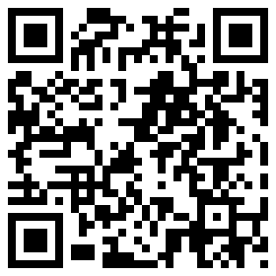
Jason Puckett Communication Librarian
Email me: jpuckett@gsu.edu
Research guide: research.library.gsu.edu/jour3950
Office hours: 1044 One Park Place Tues 1-2pm, Wed 11am-12pm or by appt 5th floor Lib South
QR code with a link to my guide
Notes:
Another mobile related option is to add QR codes to your guides. Jason is trying this out this semester at Georgia State. He used an easy online QR code generator (like http://qrcode.kaywa.com/) to create a link to his libguide – He put this up at the beginning/end of class.
Agnes Scott is considering using QR codes that link to LibGuides to help students in the stacks find more resources related to a specific call number area and placing QR codes near exhibits that will guide students to more resources on the exhibit topic.

Slide 14

_____ __ ___ __________
Tailor to the assignment
“students do not connect with general subject guides, but do find use for guides that are focused on specific courses”
“presenting sources based on a discipline was not helpful for students as the students did not understand what a discipline really was”¹
Examples
http://research.library.gsu.edu/sw7200
http://research.library.gsu.edu/jour1000
http://research.library.gsu.edu/jour4800
“course management systems … create learning environments tailored specifically to the needs of the students enrolled in a course”
“undergraduate students’ mental model is one focused on courses and coursework, rather than disciplines”²
¹Roberts, S., & Hunter, D. (2011). New Library, New Librarian, New Student: Using LibGuides to Reach the Virtual Student. Journal of Library & Information Services in Distance Learning, 5(1/2), 67-75. doi:10.1080/1533290X.2011.570552
²Reeb, B., & Gibbons, S. (2004). Students, Librarians, and Subject Guides: Improving a Poor Rate of Return. Portal : Libraries and the Academy, 4(1), 123-130.
flickr.com/photos/heartindustry/522073924
Notes:
Tailor to assignment (References: Little, Roberts/Hunter)http://research.library.gsu.edu/jour1000
http://research.library.gsu.edu/jour4800
http://research.library.gsu.edu/sw7200
We know that tailoring an instruction session with learning outcomes specifically tied to the assignment is the most effective way to deliver library instruction to students – the same is true of guides, especially for undergraduates
guides tailored to course get used more than subject guides
match the learning outcomes for the guide to the learning outcomes of the IL class session -- what do they need to know to do this assignment?
This is something J is working on in my own guides: they are a lot more immediately useful to the student if it explicitly answers the question. I used to have a “Start/Home” page on all my guides that had a catalog search box, general library info... that was generic and not necessarily relevant to their assignment. It did nothing to attract the attention of students in a specific class
“Researchers found that students do not connect with general subject guides, but do find use for guides that are focused on specific courses.” Roberts & Hunter 2011
example: persistent link to search results via EBSCO save/share link

Slide 15
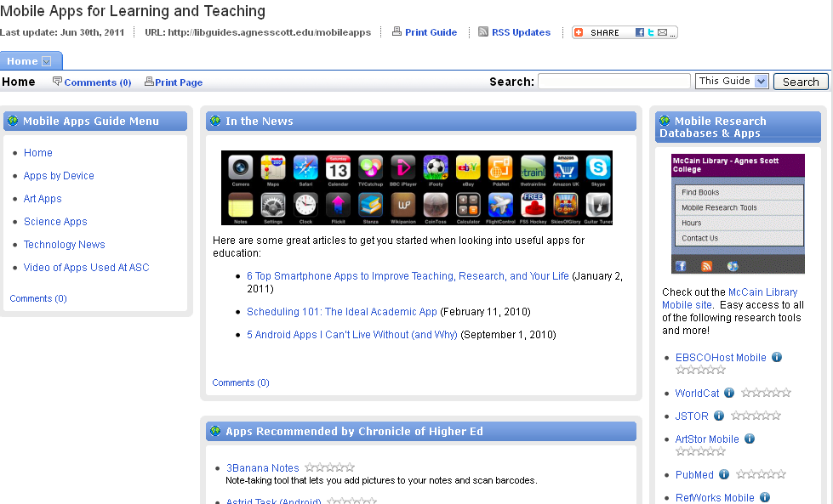
Other Uses for Libguides
Notes:
To help make Libguides a household name, consider making guides that are tailored to the interest of specific groups on campus. At Agnes Scott, we are create a guide on mobile apps in higher education that helps faculty and students quickly find some of the most popular apps for studying, research and teaching.

Slide 16
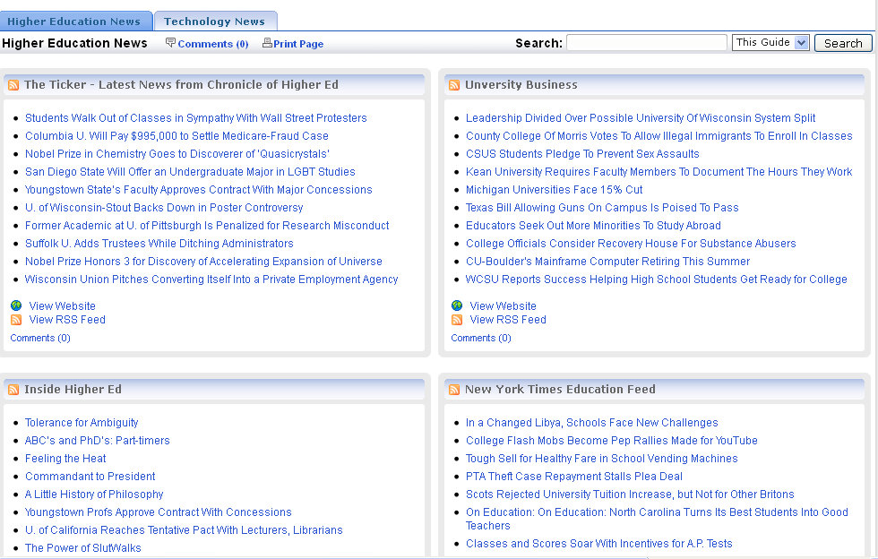
Other Uses for LibGuides
Notes:
Also at Agnes Scott we have a guide that simply lists rss feeds from the top publications in these areas. This makes the page kind of like an RSS reader for popular topics in the discipline. This screen shot shows our Keeping Up with New in Higher Education LibGuide.
16

Slide 17

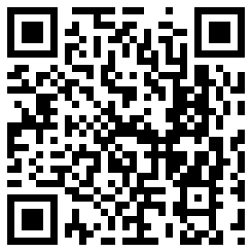
Casey Long: clong@agnesscott.edu
Jason Puckett: jpuckett@gsu.edu
Notes, references and examples:
http://libguides.agnesscott.edu/insidethebox
flickr.com/photos/fliegender/480748893

